Slide 1

Planning Microsoft Endpoint Manager deployment
Module
Notes:
Managing and protecting data, mobile devices, desktop computers, virtual machines, servers, and apps that your organization uses may seem like an intimidating task. However, after completing the modules provided below, you will have both a better understanding and a path forward to implementing Microsoft Endpoint Manager. Whether you are new to endpoint management, or are new to Microsoft Endpoint Manager, this learning path presents both planning and guidance to help you get started with or migrate to Microsoft Endpoint Manager. If you are new to endpoint management overall, consider reviewing Microsoft Endpoint Manager fundamentals. After completing the modules in this learning path, you will be ready to enroll your organization's devices and assign apps to the users at your organization.

Slide 2

Introduction Microsoft Endpoint Manager Planning
Lesson 1

Slide 3
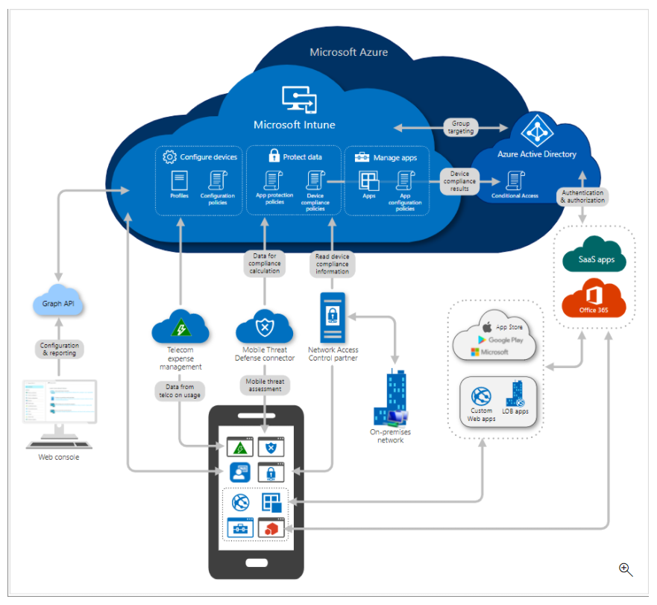
Intune service architecture

Slide 4

Microsoft Endpoint Manager Migration
After this module you should be able to accomplish the following actions:
Protect the data that the people at your organization are accessing.
Ensure your organization is using proper credentials to access and share company data.
Safeguard the devices and apps that access your organization resources.
Confirm security rules are in place based on your organizations requirements.
Notes:
This module explains the basic paths you can follow to migrate from your existing endpoint management state to Microsoft Endpoint Manager. Microsoft Endpoint Manager is a single, modern, integrated management platform for managing, protecting, and monitoring all of your organization's endpoints. Endpoints include the mobile devices, desktop computers, virtual machines, embedded devices, and servers that your organization uses. Additionally, endpoints include the apps used by your organization.

Slide 5
CSPOG Scenario
Mike is an Administrator for CSPOG Energy, a North American company with several thousand employees.
CSPOG must determine the best path to manage end-user:
Devices
Apps, and
Apps Data
Currently you have no Mobile MDM (Mobile Device Management) solution. This is a concern to the Executive management. You decide to investigate the benefits of MEM and create a Migration path.
Notes:
The Microsoft Endpoint Manager console helps keep your organization's cloud and on-premises devices, apps, and data secure. Endpoint Manager integrates Microsoft Intune, Microsoft Endpoint Configuration Manager, Analytics, and Windows Autopilot. In addition, Microsoft Endpoint Manager integrates with specific technologies, such as Office 365, Microsoft Defender for Endpoint, Azure Active Directory, and Azure Information Protection.
Suppose that you're the administrator or business decision maker of a company with several thousand employees. Your company must determine the best path to manage end users devices, apps, and data. You currently have no Mobile Device Management (MDM) solution. You need to keep your corporate data safe by protecting data, apps, and devices that your employees use, and maximize the return on your investment. Learn how Microsoft Endpoint Manager can be a part of your device management migration path.

Slide 6
Lesson objectives
In this lesson, you will:
Determine your organization's endpoint migration starting point.
Understand the possible endpoint migrations paths.
Learn about the different benefits that each migration path offers.
Start planning the migration process to modern endpoint management.

Slide 7

Determine your endpoint management migration starting point
Notes:
When you have decided to migrate your organization to Microsoft Endpoint Manager, you must determine where to start. You must confirm the endpoint management solution you and your organization currently use. Then, determine the direction and solution that will make the most sense for you and your organization.

Slide 8

Enterprise Mobility Management (EMM) direction
Consider the following questions:
Is your organization's devices, apps, and data currently managed in the cloud, on-premises, a combination of both cloud and on-premises, or not managed at all?
Do you need to have your organization's devices, apps, and data managed in the cloud, on-premises, or a combination of both cloud and on-premises?

Slide 9
Basic migration path:
Limited or no existing endpoint management tools
01
Existing third-party mobile device management provider
02
Existing on-premises endpoint management implementation
03
Existing on-premises group policy
04
Notes:
This lesson and Module describes four basic paths you should consider when migrating from your existing endpoint management state to Microsoft Endpoint Manager. These paths describe the possible starting points of your organization's endpoint management solution or state. Each path provides the basic direction you should consider, as well as the migration benefits and additional value that your organization will gain by migrating to Microsoft Endpoint Manager. The basic paths are the following:
Limited or no existing endpoint management tools
Existing third-party mobile device management provider
Existing on-premises endpoint management implementation
Existing on-premises group policy

Slide 10

Understand Service Migration

Slide 11

From a Limited Endpoint Management Solution point of view

Slide 12
Little to No Modern Endpoint Management Tools
Move directly to cloud endpoint management using Microsoft Intune.
Use tenant attach or co-management with Microsoft Endpoint Configuration Manager.
Notes:
When your organization has little to no modern endpoint management tools in use, you should consider either of the following options:
Move directly to cloud endpoint management using Microsoft Intune.
Use tenant attach or co-management with Microsoft Endpoint Configuration Manager.
Both of these endpoint management solutions are part of Microsoft Endpoint Manager. If you don't have a requirement to manage some devices on-premises, solely using Microsoft Intune may best fit your needs. Microsoft Intune, which is part of Microsoft Endpoint Manager, provides the cloud infrastructure, the cloud-based mobile device management (MDM), cloud-based mobile application management (MAM), and cloud-based PC management for your organization. It lets you protect your organization by controlling features and settings on Android, Android Enterprise, iOS/iPadOS, macOS, and Windows 10/11 devices. It integrates closely with Azure Active Directory (Azure AD) for identity and access control and it integrates with Azure Information Protection and other advanced threat protection products for data protection.
If you need to use both cloud and on-premises device management, consider using tenant attach or co-management with Microsoft Endpoint Configuration Manager. Microsoft Endpoint Configuration Manager is the leading PC management solution on the market. You use it to manage desktops, servers, and laptops that are on your network or are internet-based. If you use Configuration Manager, you should attach your Configuration Manager deployment to the Microsoft 365 cloud, which will provide integration with Intune, Azure AD, Microsoft Defender for Endpoint, and other cloud services. Use Configuration Manager to deploy apps, software updates, and operating systems, as well as configure sites and clients, and run and monitor management tasks. Configuration Manager supports Windows and macOS versions.

Slide 13

Benefits of using Intune
Following benefits:
No need to set up and operate your own management infrastructure.
Native integration with cloud-powered security controls and risk-based Conditional Access for apps and data.
Flexible support for diverse corporate and bring-your-own-device (BYOD) scenarios, while increasing productivity and collaboration.
Maximize your investment and accelerate time to value with fast rollout of services and devices with end-to-end integration across familiar Microsoft stack.

Slide 14
Benefits of using Configuration Manager
When you enroll Configuration Manager clients in co-management, you gain the following immediate value:
Conditional Access with device compliance
Intune-based remote actions, such as restart, remote control, or factory reset
Centralized visibility of device health
Link users, devices, and apps with Azure Active Directory (Azure AD)
End-to-end, robust OS deployment with Windows Autopilot
Optionally extend your device management infrastructure using co-management with Configuration Manager.

Slide 15
Don't use any MDM or MAM provider?
Two options:
Option 1:
Intune + Endpoint Manager
Option 2:
Configuration Manager + Endpoint Manager
Important: Don't configure Intune and your existing third party MDM solution to apply access controls to resources, including Exchange or SharePoint Online.
Notes:
Currently don't use anything
If you currently don't use any MDM or MAM provider, then you have some options:
Intune + Endpoint Manager: If you want a cloud solution, then consider going straight to Intune. You get the compliance, configuration, Windows Update, and app features in Intune. You also get the benefits of the Endpoint Manager admin center, which is a web-based console.
Next, deploy Intune (in this article).
Configuration Manager + Endpoint Manager: If you want the features of Configuration Manager (on-premises) combined with the cloud, then consider tenant attach or co-management. With Configuration Manager, you can:
Manage on-premises devices, including Windows Server or Windows 8.1 devices.
Manage partner or third party software updates.
Create custom task sequences when deploying operating systems.
Deploy and manage many app types.
To help you decide, see choose a device management solution.

Slide 16
Migration from a third-party mobile device management provider
It lets you protect your organization by controlling features and settings on:
Android, Android Enterprise,
iOS/iPadOS, macOS, and
Windows 10/11 devices.
integrates closely with Azure Active Directory (Azure AD) for identity and
access control,
Azure Information Protection for data protection.
Notes:
f you're using an existing cloud-based mobile device management provider, you should consider moving your existing endpoints and workloads to Microsoft Intune to achieve modern endpoint management. For cloud-based device management scenario, endpoint management can be accomplished for desktops and devices in the same way.
Note
Devices should only have one Mobile Device Management (MDM) provider.
As previously mentioned in this module, Microsoft Intune is available within Microsoft Endpoint Manager. It's a modern cloud-based mobile device management (MDM) and mobile application management (MAM) provider for your devices and apps. It lets you protect your organization by controlling features and settings on Android, Android Enterprise, iOS/iPadOS, macOS, and Windows 10/11 devices. It integrates closely with Azure Active Directory (Azure AD) for identity and access control, as well as Azure Information Protection for data protection.

Slide 17

Benefits of using Intune
Benefits:
No need to set up and operate your own management infrastructure.
Native integration with cloud-powered security controls and risk-based Conditional Access for apps and data.
Flexible support for diverse corporate and bring-your-own-device (BYOD) scenarios, while increasing productivity and collaboration.
Maximize your investment and accelerate time to value with fast rollout of services and devices with end-to-end integration across familiar Microsoft stack.

Slide 18
Extend or migrate on-premises Endpoints
Current Microsoft Endpoint Configuration Manager:
add cloud-attach management
Configuration Manager supports Windows and
macOS devices
cloud attach allows you to leverage both Configuration Manager and
Microsoft Intune from Microsoft Endpoint Manager.
Currently using on-premises device consider
Moving your endpoints to Configuration Manager.
Move toward, co-management with Intune and Configuration Manager.
Notes:
If you're currently using Microsoft Endpoint Configuration Manager as your on-premises management solution, you can easily add cloud-attach management. Configuration Manager supports Windows and macOS devices. And, cloud attach allows you to leverage both Configuration Manager and Microsoft Intune from Microsoft Endpoint Manager.
If you currently use an on-premises device management platform other than Configuration Manager, consider moving your endpoints to Configuration Manager. Going forward, you will also have the option to use co-management with Intune and Configuration Manager.
You use Configuration Manager to manage desktops, servers, and laptops that are on your network or are internet-based. If you use Configuration Manager, you should attach your Configuration Manager deployment to the Microsoft 365 cloud, which will provide integration with Intune, Azure AD, Microsoft Defender for Endpoint, and other cloud services.

Slide 19

Benefits
Manage
Desktops,
servers, and
laptops on the local network or are internet-based architecture.
Configuration Manager, can attach your Configuration Manager deployment to the Microsoft 365 cloud,
Will provide integration with Intune,
Azure AD,
Microsoft Defender for Endpoint, and
other cloud services.
Notes:
As previously mentioned in this module, Configuration Manager is the leading PC management solution on the market. You use it to manage desktops, servers, and laptops that are on your network or are internet-based. If you use Configuration Manager, you should attach your Configuration Manager deployment to the Microsoft 365 cloud, which will provide integration with Intune, Azure AD, Microsoft Defender for Endpoint, and other cloud services. Use Configuration Manager to deploy apps, software updates, and operating systems, as well as configure sites and clients, and run and monitor management tasks. Configuration Manager supports Windows and macOS versions. The devices you manage with Configuration Manager can run in virtual environments. This includes Hyper-V on Windows servers as well as Virtual Machines (VM) in Azure. If you run a server as an Azure-based VM, you can install the Configuration Manager client on that device.

Slide 20

Benefits of co-management
By moving your additional endpoint to Intune to manage your organization's endpoints, you gain the following benefits:
Native integration with cloud-powered security controls and risk-based Conditional Access for apps and data.
Flexible support for diverse corporate and bring-your-own-device (BYOD) scenarios while increasing productivity and collaboration.
Maximize your investment and accelerate time to value with fast rollout of services and devices with end-to-end integration across familiar Microsoft stack

Slide 21

Benefits of co-management
Benefits of using co-management:
Conditional Access with device compliance
Remote actions from Intune
Configuration Manager client health
Azure Active Directory (Azure AD)
Modern provisioning - Windows Autopilot
Web-based admin for Configuration Manager
Unified helpdesk and troubleshooting
Cloud intelligence drive management

Slide 22

Benefits of co-management
Two main paths to reach co-management:
Existing Configuration Manager clients
New internet-based devices
Notes:
two main paths to reach co-management:
Existing Configuration Manager clients: You have Windows 10/11 devices that are already Configuration Manager clients. You set up hybrid Azure AD, and enroll them into Intune.
New internet-based devices: You have new Windows 10/11 devices that join Azure AD and automatically enroll to Intune. You install the Configuration Manager client to reach a co-management state.
Note
It's important to understand that you have more than one option when considering a migration path to device management in the cloud. Any of the following options will put you on the path to modern endpoint management:
Add tenant attach with Microsoft Endpoint Configuration Manager
Set up co-management with Microsoft Endpoint Configuration Manager
Move from Configuration Manager to Intune
Start from scratch with Microsoft 365 and Intune

Slide 23

Migration from Existing On-premises Group policy

Slide 24
Device configuration profiles
On Windows 10/11 devices, use a profile template that blocks ActiveX controls in Internet Explorer.
On iOS/iPadOS and macOS devices, allow users to use AirPrint printers in your organization.
Allow or prevent access to bluetooth on the device.
Create a WiFi or VPN profile that gives different devices access to your corporate network.
Manage software updates, including when they're installed.
Run an Android device as dedicated kiosk device that can run one app, or run many apps.
Notes:
Microsoft Intune includes settings and features you can enable or disable on different devices within your organization. These settings and features are added to "configuration profiles". You can create profiles for different devices and different platforms, including iOS/iPadOS, Android device administrator, Android Enterprise, and Windows. Then, use Intune to apply or "assign" the profile to the devices.
As part of a MDM solution, you can use these configuration profiles to complete different tasks. Some profile examples include:
On Windows 10/11 devices, use a profile template that blocks ActiveX controls in Internet Explorer.
On iOS/iPadOS and macOS devices, allow users to use AirPrint printers in your organization.
Allow or prevent access to bluetooth on the device.
Create a WiFi or VPN profile that gives different devices access to your corporate network.
Manage software updates, including when they're installed.
Run an Android device as dedicated kiosk device that can run one app, or run many apps.

Slide 25

Group policy objects
automated logon process:
Autologon restrictions
Administrator account renaming
Legal banners and captions
Restrictive security policies
Notes:
Group policy objects (GPOs) are primarily used on-premises to configure settings on Windows computers, but also can include remote Windows devices. In device management, GPOs help control security and features in the Windows OS, Internet Explorer, Office apps, and more. Group policy provides the capability to manage a large number of Active Directory Domain Services (AD DS) computer and user objects through a centralized, one-to-many model. Group Policy settings are contained in a group policy object and linked to one or more AD DS service containers—sites, domains, and organizational units (OUs). Note that devices do not have to be domain-joined to apply GPOs.
Some organizations have Group Policy settings that are restrictive and could cause problems during operating system deployments. For example, the following group policy settings can interrupt an automated logon process:
Autologon restrictions
Administrator account renaming
Legal banners and captions
Restrictive security policies
If your organization uses GPOs and you want to move some workloads to Microsoft Endpoint Manager and Intune, then Group Policy analytics will help.

Slide 26

Group policy analytics
Microsoft Endpoint Manager that analyzes your GPOs
Translates them in the cloud.
output shows which settings are supported in MDM providers, including:
Microsoft Intune
deprecated settings
ettings not available to MDM providers
Notes:
Many organizations are looking at cloud solutions to support the growing remote workforce. Group Policy analytics is a tool and feature in . It helps you determine how your GPOs The output shows which settings are supported in MDM providers, including Microsoft Intune. It also shows any deprecated settings, or settings not available to MDM providers.

Slide 27
Knowledge check
What are the benefits of protecting and monitoring your organization's endpoints using a modern endpoint management solution?
A modern endpoint management solution ensures devices are used for organization access only.
A modern endpoint management solution safeguards your organization, except for device security.
A modern endpoint management solution must provide data protection, ensure proper credentials are used, safeguard the devices and apps, and confirm security rules are in place based on your organizations requirements.
What are the four Mobile Device Management (MDM) migration paths mentioned in this module?
Migration paths: Limited or no existing management tools, existing third-party cloud management provider, existing on-premises management implementation, and existing on-premises group policy.
Migration paths: Limited devices, existing third-party devices, and existing on-premises devices.
Migration paths: No current end users, existing end users using third-party devices, and existing end users using on-premises devices.
If your organization has little to no modern endpoint management tools in use, what is the recommended path to endpoint management as mentioned in this module?
Consider moving directly to the Azure cloud.
Consider moving directly to cloud endpoint management with Microsoft Intune.
Consider moving directly to co-management using with Microsoft Intune.
Notes:
C
A
B

